Slide 1

A NEW HINT TO TRANSPORTATION – ANALYSIS OF NYC BIKE SHARE SYSTEM
TEAM ID : PNT2022TMID27940
BY:
SHRUTHI S
NITHYA B
SANTHOSH M
THANUSH V

Slide 2



VERY PERI

Slide 3
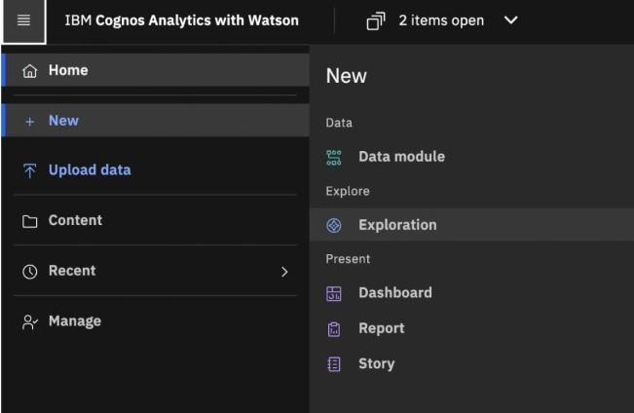
Data exploration by creating dashboard in IBM Cognos analytics

Slide 4
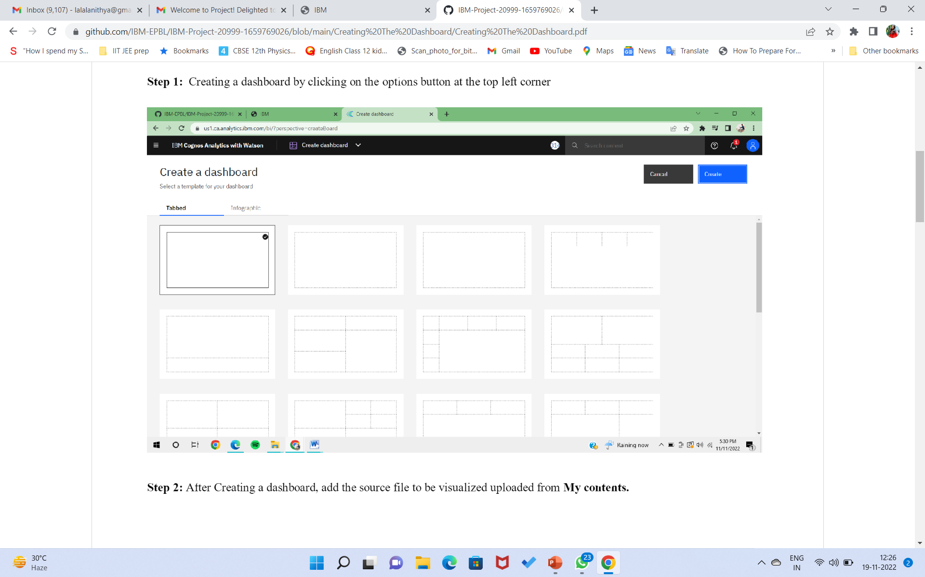
CREATING DASHBOARD

Slide 5
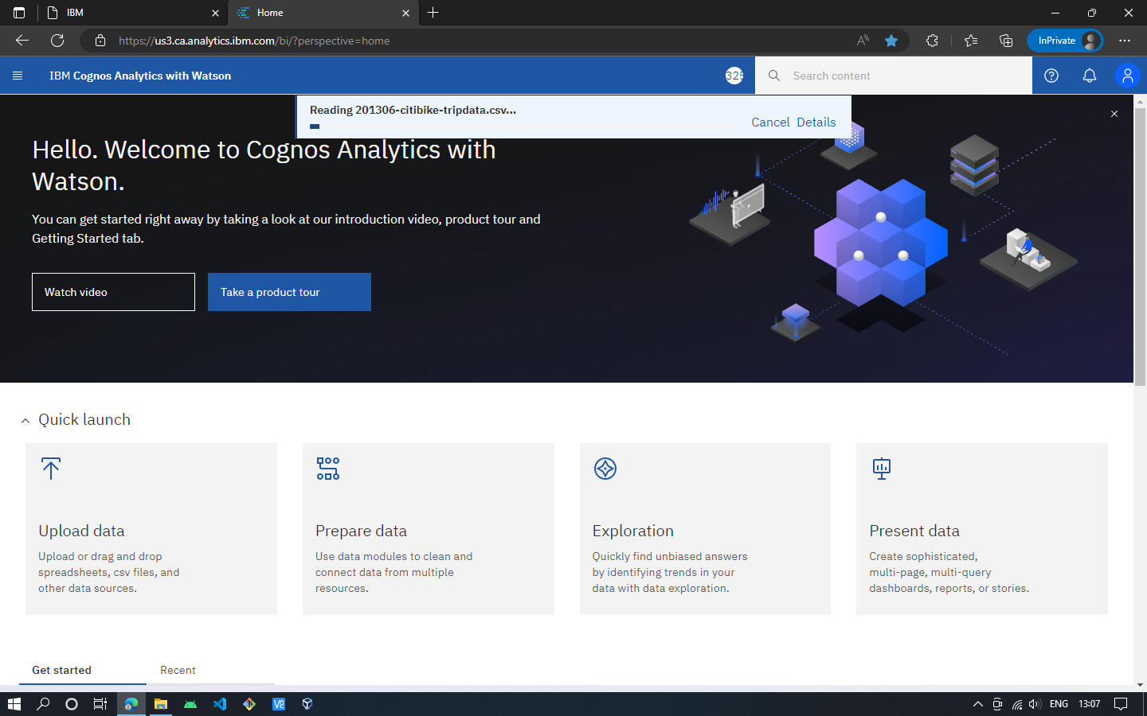
UPLOADING THE DATASET

Slide 6
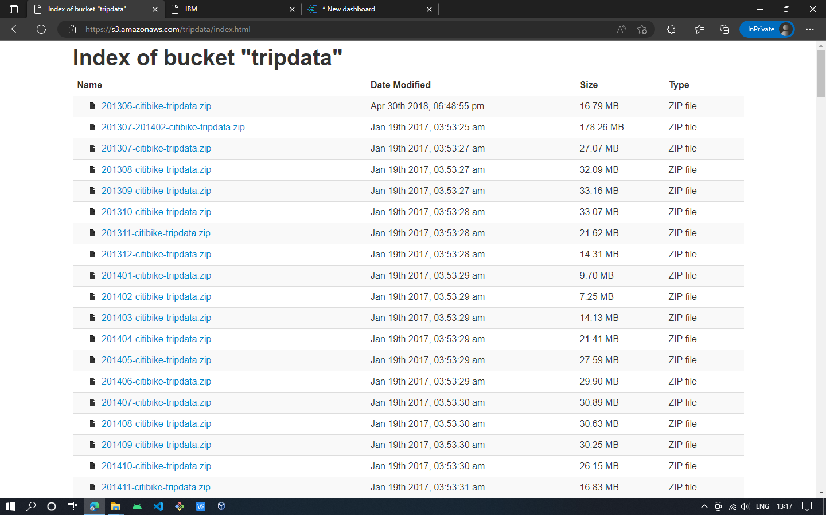
DOWNLOADING THE DATASET

Slide 7
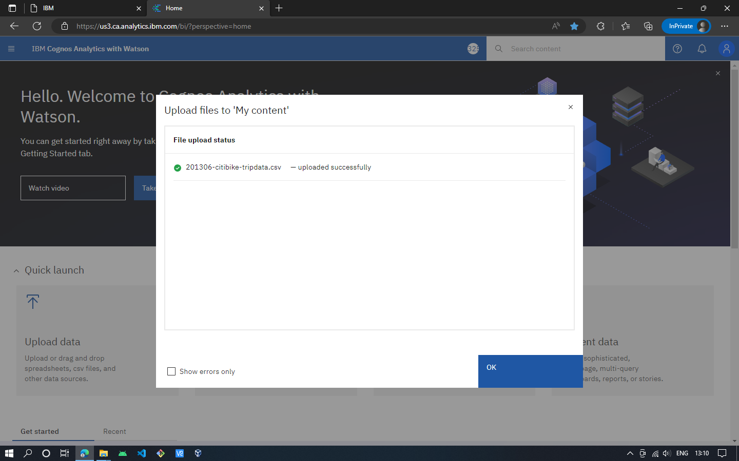

Slide 8
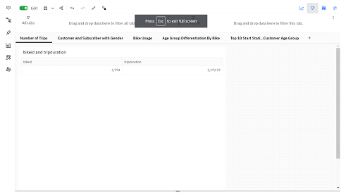
Number of trips

Slide 9
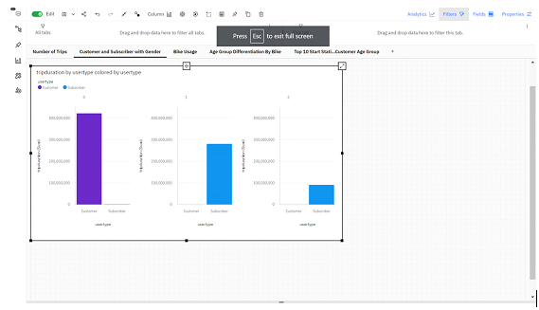
Customer and subscriber with gender

Slide 10
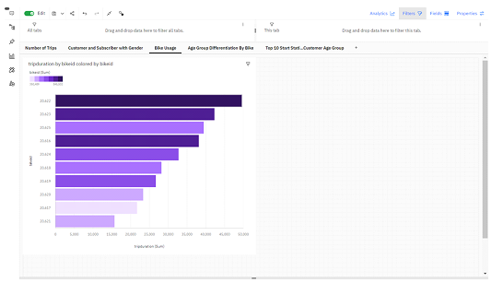
Bike usage

Slide 11

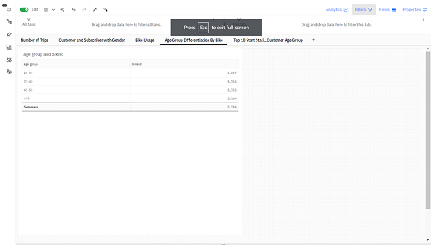
Age group differentiation

Slide 12

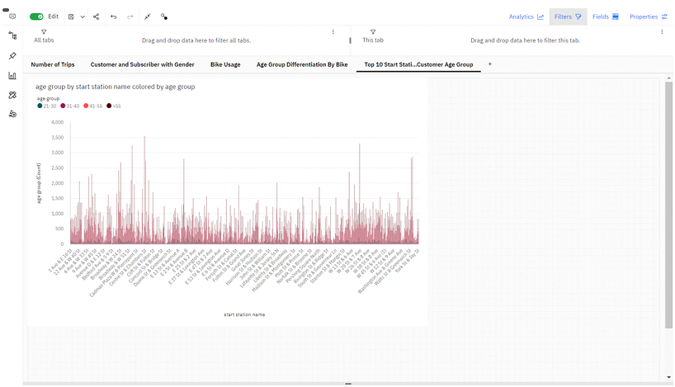
Top 10 start station names with respect to Customer
Age group

Slide 13

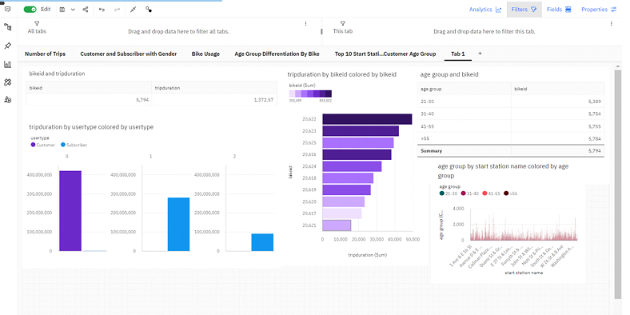
Dashboard

